Slide 1


KLE INSTITUTE OF TECHNOLOGY
DEPARTMENT OF COMPUTER SCIENCE & ENGINEERING
TOPIC: SIGN LANGUAGE DETECTION USING DEEP LEARNING TECHNIQUES
GROUP MEMBERS:
PRAVEEN U SIDDANAGOUDAR [2KE19CS068]
PRIYANKA B MANAGAVI [2KE19CS073]
RAAVI SAI [2KE19CS075]
SUSHMA GANIGER [2KE20CS410]
Under the Guidance of:
Prof . Vijeeta Patil

Slide 2
CONTENT
Abstract
Introduction
Problem Statement
Objectives
Literature Survey
Methodology
Implementation
Outcomes
References

Slide 3
Abstract
Sign Language is mainly used by deaf (hard hearing) and dumb people to exchange information between their own community and with other people. It is a language where people use their hand gestures to communicate as they can’t speak or hear.
Sign Language Recognition (SLR) deals with recognizing the hand gestures acquisition and continues till text or speech is generated for corresponding hand gestures.
Deep Learning Computer Vision is used recognize the hand gestures by building Deep Neural Network architectures (Convolution Neural Network Architectures) where the model will learn to recognize the hand gestures images.
Based as proposed in Literature Survey the CNN model emerged with the highest performance, attaining training and testing accuracy of 98.8%.
1

Slide 4
Introduction
Sign language is used to communicate by those who are deaf or hard of hearing. People employ nonverbal communication such as sign language movements to communicate their thoughts and emotions. Non-signers, on the other hand, have a hard time understanding it, which is why skilled sign language interpreters are required for medical and legal consultations, as well as educational and training sessions.
Over the last few years, the demand for translation services has significantly increased. Other methods have been devised, such as video remote human interpreting using high-speed Internet connections. As a result, they will provide a simple sign language translating service that may be used but has significant restrictions.
2

Slide 5
Problem Statement
Learning sign language is also time consuming as there are no effective, portable tool for recognizing sign language.
Hearing or Speech disabled people who know Sign Language require a translator who also knows Sign Language to explain their thoughts to other people in an effective manner.
To help overcome these problems, we are building a real time sign language detection and recognition system which helps hearing or speech disabled people to learn as well as translate their sign language.
We are building a solution which is faster and less resource intensive so that it can be implemented on low-end computing devices like for better portability and affordability.
3

Slide 6
Objectives
1.Data collection: To collect a large and diverse dataset of sign language images. This dataset should cover a wide range of signs and gestures.
2. Data preprocessing: The collected images need to be preprocessed before they can be used for training a deep learning model.
3.Feature extraction: Next, the relevant features need to be extracted from the preprocessed images. This can involve techniques such as skeletal joint detection.
4

Slide 7
4. Model training: To train a deep learning model, such as a convolutional neural network (CNN).
5. Model evaluation: After the model is trained, it needs to be evaluated on a separate test dataset to determine its accuracy and performance.
6. Deployment: Once the model is trained and validated, it can be deployed for real-world use.

Slide 8
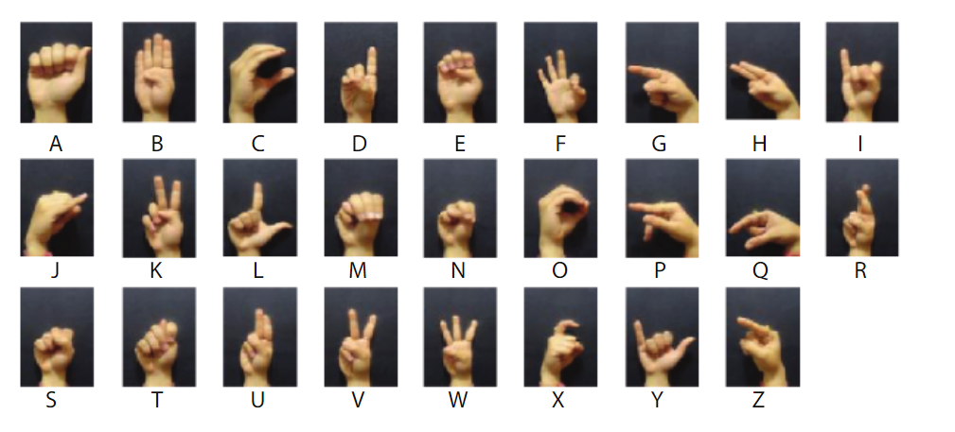
Sample data sets
Fig .The ISL single-handed alphabet signs data set

Slide 9
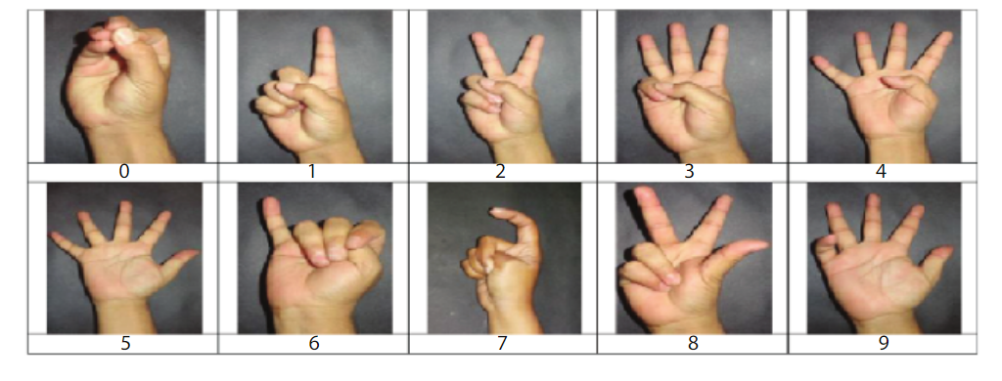
Fig. The ISL digit signs data set.

Slide 10
Literature Survey
No. | Title of the Paper | Author and Year | Advantage | Disadvantage
1 | A Signer Independent Sign Language Recognition with Co-articulation Elimination from Live Videos: an Indian Scenario | P.K. Athira, C.J. Sruthi, A. Lijiya (2019) | Economical can be implemented with a mobile camera which makes it very user-friendly. | Not efficient under cluttered backgrounds and different illumination conditions
2 | A Deep Learning based Indian Sign Language Recognition System | Sruthi C. J and Lijiya A(2019) | Training accuracy of 99.93% and with testing and validation accuracy of 98.64%. | Hand gestures and context analysis are the other part not included
3 | An Efficient Binarized Neural Network for Recognizing Two Hands Indian Sign Language Gestures in Real-time Environment | Mohita Jaiswal, Vaidehi Sharma, Abhishek Sharma, Sandeep Saini, Raghuvir Tomar (2020) | Using this architecture achieves an overall accuracy of 98.8% which is higher than other existing methods. | This system misclassifies some signs of M, N, E because of their similar kind of shapes, and also, the proposed BNN architecture is limited to a small no of classes of gestures.
5

Slide 11
No. | Title of the Paper | Author and Year | Advantage | Disadvantage
4 | Hand Gesture Recognition for Sign Language Using 3DCNN | Muneer Al-Hammadi, Ghulam Muhammad, Wadood Abdul, Mansour Alsulaiman, Mohamed A.Bencherif,And Mohamed Amine Mekhtiche (2020) | The proposed approaches Were compared with six other state-of-the-art methods from the literature.They outperformed four of these methods and showed comparable performance to the other two. | Does not work for a live video feed.
5 | Sign Language Recognition Using RF Sensing | Z. Gurbuz, Ali Cafer Gurbuz, Evie A. Malaia, Darrin J. Griffin, Chris S. Crawford Sevgi, Mohammad Mahbubur Rahman (2020) | Results demonstrate the eventuality of RF sensing to give contactless ASL Recognition capabilities in aid of ASL-sensitive smart surroundings while surviving effectively in the dark and guarding user privacy. | A massive intermodal database of connected Native signing would be required to make meaningful interpretations for technology and algorithm correlation.
6

Slide 12
No. | Title of the Paper | Author and Year | Advantage | Disadvantage
6 | Video-based isolated hand sign language recognition using a deep cascaded model | Razieh Rastgoo1 Kourosh Kiani Sergio Escalera (2020) | The accuracy and complexity of hand sign recognition were improved by this model. In case of an uncontrolled environment such as rapid hand motions, it provided fast processing. | Using more data, the accuracy of detection can be improved.
7 | A Modified-LSTM Model for Continuous Sign Language Recognition using Leap motion | Anshul Mittal, Pradeep Kumar, Partha Pratim Roy, Raman Balasubramanian, and Bidyut B. Chaudhuri (2019) | Average accuracies of 72.3% and 89.5% have been recorded on the signed sentences and isolated sign words, respectively | The recognition performance can be improved by increasing more training data for better model learning.
8 | A depth-based Indian Sign Language recognition using Microsoft Kinect | T Raghuveera, R Deepthi, R Mangalashri, and R Akshaya (2019) | The average recognition accuracy was improved up to 71.85% with this method. The system achieved 100% accuracy for a few signs. | The system doesn’t consider the environment of gestures, leading to incorrect translations on many occasions.

Slide 13
No. | Title of the Paper | Author and Year | Advantage | Disadvantage
9 | Deep learning-based sign language recognition system for static signs | Ankita Wadhawan, Parteek Kumar (2020) | The authors achieved the highest training Accuracy of 99.17% and validation accuracy of 98.80%,concerning changes in the number of layers and filters | To refine the recognition method, there is a need to collect more datasets.
10 | Deep Convolutional Neural Networks for Sign Language Recognition | G. Anantha Rao, K. Syamala, P.V.V. Kishore, A.S.C.S. Sastry (2018) | A less amount of training and validation loss is observed with the proposed CNN architecture. | The database is not available publicly.

Slide 14
Methodology
Fig. Conceptual Framework for Sign Language Detection system
for static images
9

Slide 15
CONTIN…
The system will be implemented through a desktop with a 1080P Full-HD web camera. The camera will capture the images of the hands that will be fed in the system. Note that the signer will adjust to the size of the frame so that the system will be able to capture the orientation of the signer’s hand.
Fig. illustrates the conceptual framework of the system. When the camera has already captured the gesture from the user, the system classifies the test sample and compares it in the stored gestures in a dictionary, and the corresponding output is displayed on the screen for the user..
10

Slide 16
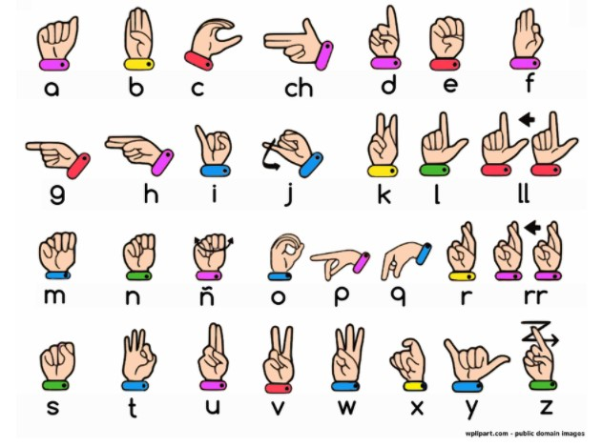
Implementation
1.Data collection: To collect a large and diverse dataset of sign language images. This dataset should cover a wide range of signs and gestures.

Slide 17
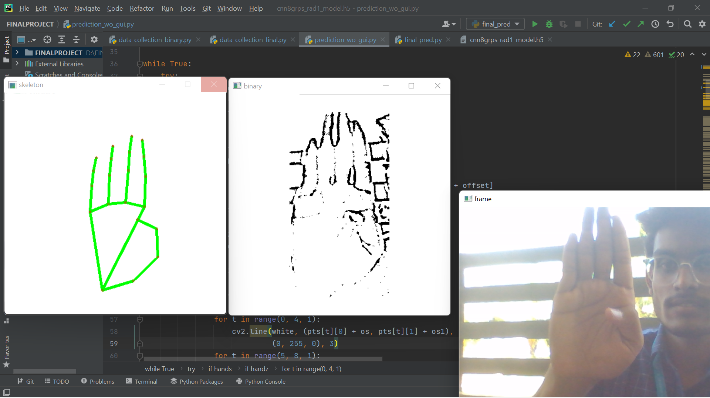
2. Data preprocessing: The collected images need to be preprocessed before they can be used for training a deep learning model. This can involve tasks such as resizing, cropping, and normalization.

Slide 18
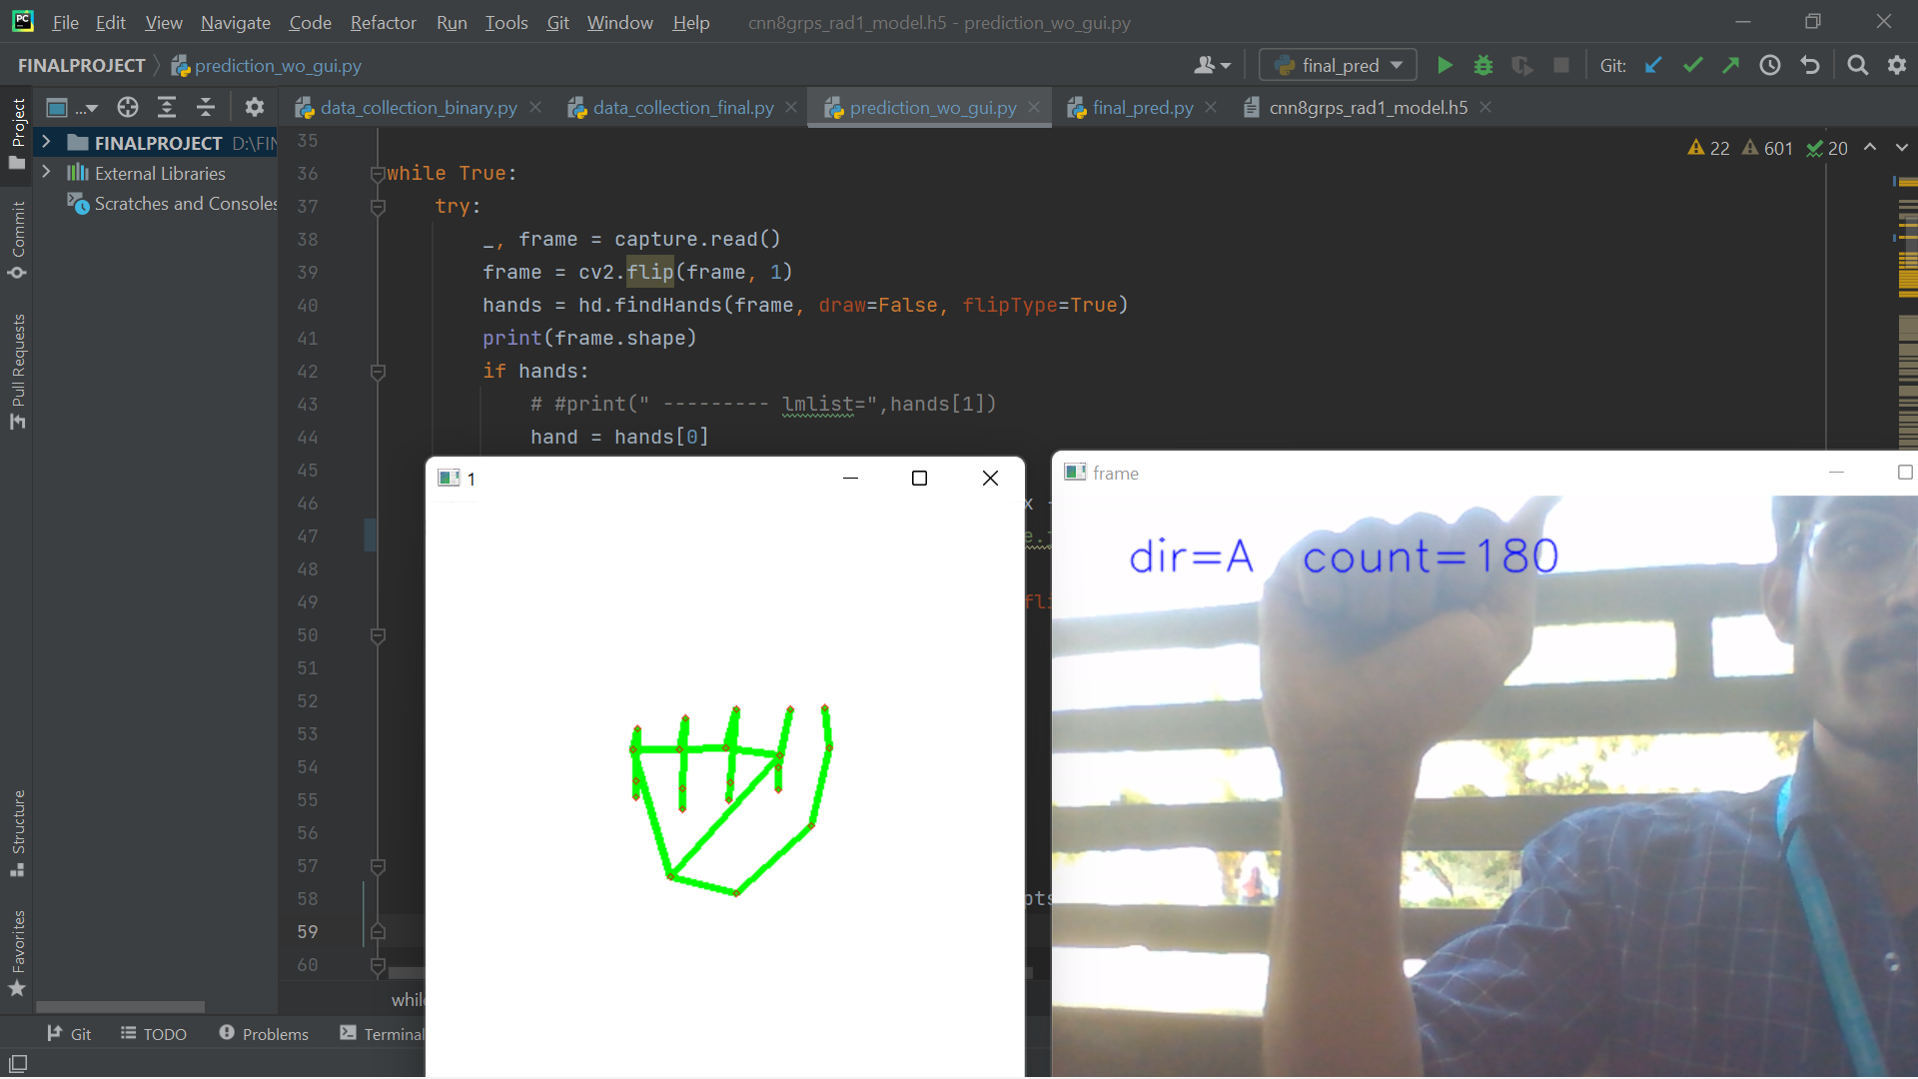
3.Feature extraction: Next, the relevant features need to be extracted from the preprocessed images. This can involve techniques such as skeletal joint detection, or hand tracking.

Slide 19
Outcomes
A deep learning model that combines the use of CNNs, computer vision techniques for sign language recognition.
A comprehensive and diverse dataset of sign language gestures, collected through partnerships with the deaf and hard-of-hearing community.
An evaluation of the performance of the model, including its accuracy in recognizing sign language gestures, its efficiency, and its robustness to various real-world scenarios.
An intuitive and user-friendly interface for the sign language recognition system, making it accessible for a wide range of users.
An exploration of the potential impact of the sign language recognition system on the deaf and hard-of-hearing community and the field of assistive technology, including discussions on increasing accessibility and empowering the community.
Recommendations for future work, such as incorporating additional computer vision techniques, improving the interpretability of the deep learning models, and creating more interactive and user-friendly interfaces for the sign language recognition system.
15

Slide 20
References
Brill R. 1986. The Conference of Educational Administrators Serving the Deaf: A History. Washington, DC: Gallaudet University Press.
P. K. Athira, C. J. Sruthi, A. Lijiya, “A Signer Independent Sign Language Recognition with Co-articulation Elimination from Live Videos: An InScenario”,2019.https://www.sciencedirect.com/science/article/pii/S131915781831228X
M. Jaiswal, V. Sharma, A. Sharma, S. Saini, R. Tomar, “An Efficient Binarized Neural Network for Recognizing Two Hands Indian Sign Language Gestures in Real-time Environment”,2020https://ieeexplore.ieee.org/abstract/document/9342454
C. J. Sruthi, A. Lijiya, “Signet: A Deep Learning based Indian Sign Language Recognition System”,2019.https://ieeexplore.ieee.org/abstract/document/8698006
13

Slide 21
T. Raghuveera, R. Deepthi, R. Mangalashri, R. Akshaya, “A depth-based Indian Sign Language recognition using Microsoft Kinet https://link.springer.com/article/10.1007/s12046-019-1250-6.
. A. Wadhawan, P. Kumar, “Deep learning-based sign language recognition system for static signs”, 2020.https://link.springer.com/article/10.1007/s00521-019-04691-y
S. Z. Gurbuz, A. C. Gurbuz, E. A. Malaia, D. J. Griffin, C. S. Crawford, M. M. Rahman, E. Kurtoglu, R. Aksu,T. Macks, R. Mdrafi, “American Sign Language Recognition Using RF Sensing”, 2020.https://ieeexplore.ieee.org/abstract/document/9187644
M. Al-Hammadi, G. Muhammad, w. Abdul, M. Alsulaiman, M. A. Bencherif, M. A. Mekhtiche, “Hand Gesture Recognition for Sign Language Using 3DCNN”, 2020.https://ieeexplore.ieee.org/abstract/document/9078786
R. Rastgoo, K. Kiani, S. Escalera, “Video-based isolated hand sign language recognition using a deep cascaded model”, 2020.https://link.springer.com/article/10.1007%2Fs11042-020-09048-5
G. A. Rao, K. Syamala, P. V. V. Kishore, A. S. C. S. Sastry, “Deep Convolutional Neural Networks for Sign Language Recognition”, 2018. https://ieeexplore.ieee.org/abstract/document/8316344.

Slide 22
THANK YOU

